Slide 1
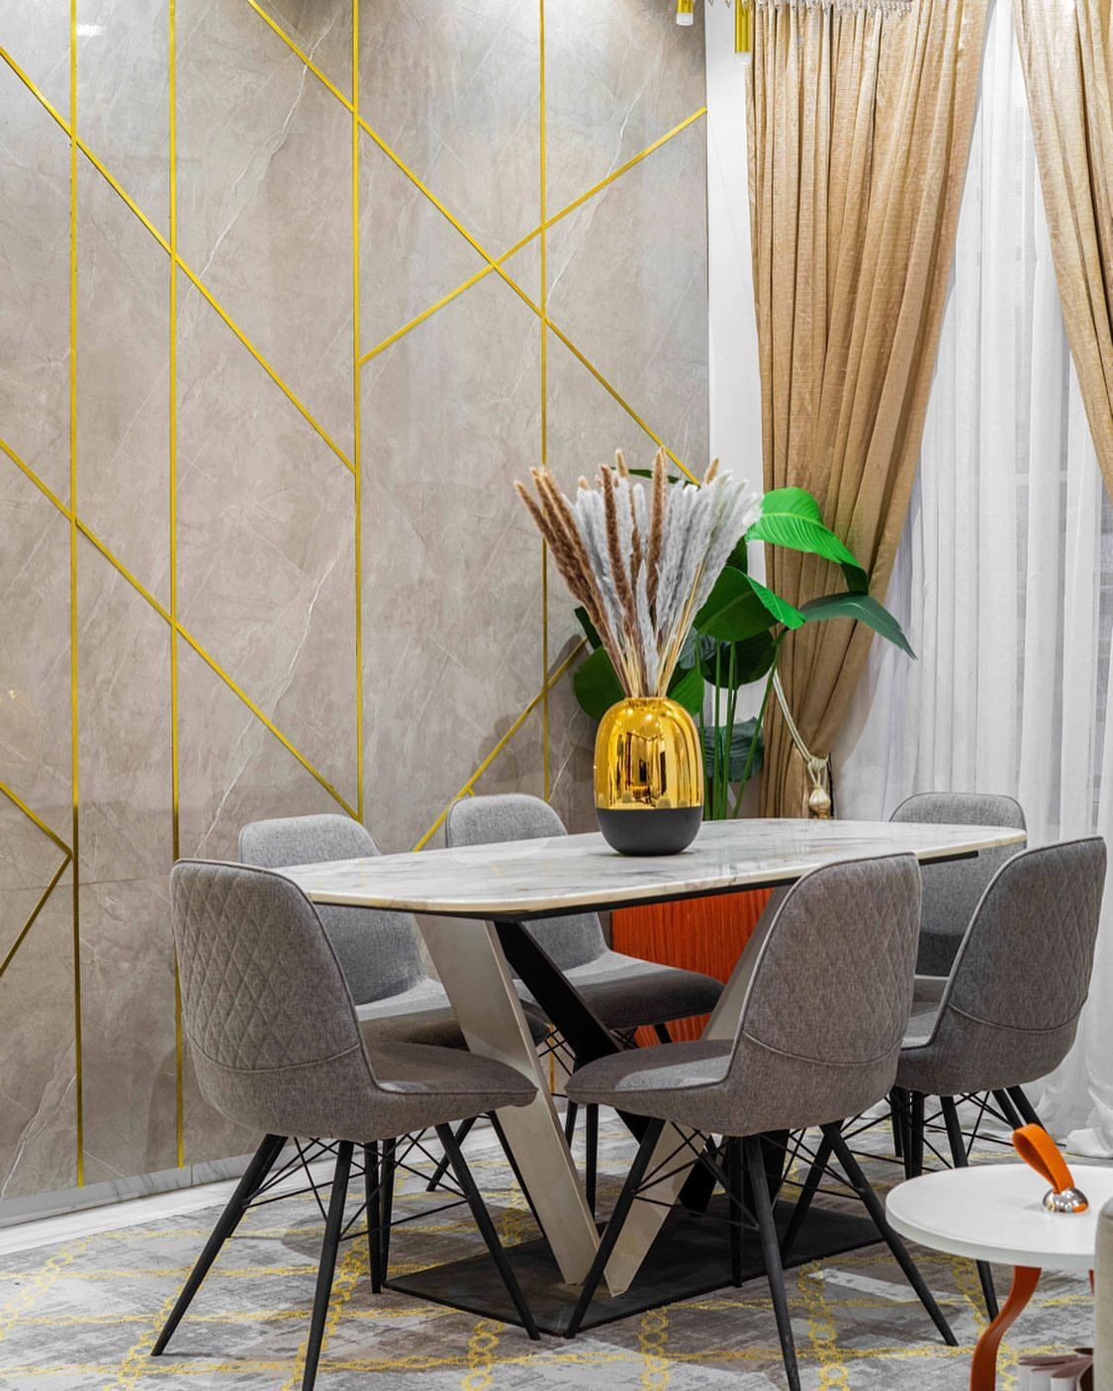
Dining room
"This dining room is a perfect blend of charm and functionality. The layout is inviting, with ample space for gatherings. The color scheme is warm, creating a cozy atmosphere. High-quality materials are used throughout.

